Slide 1
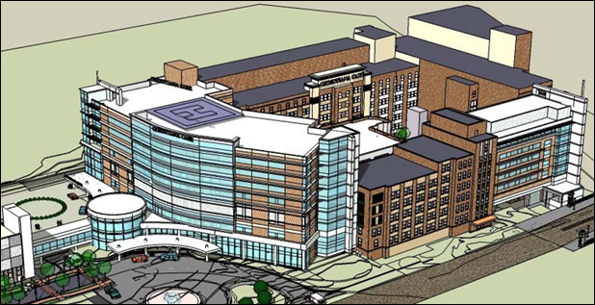
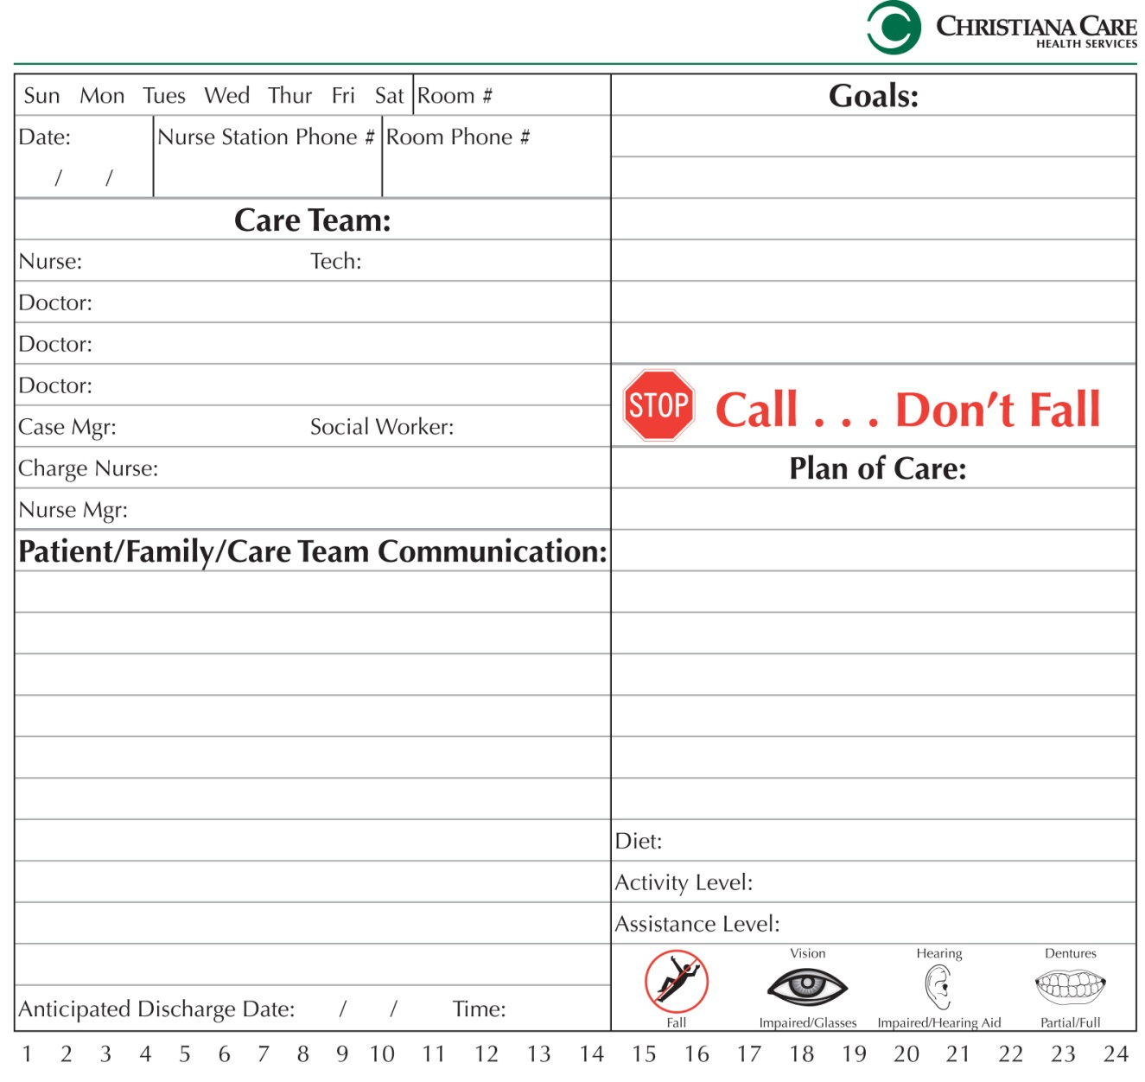
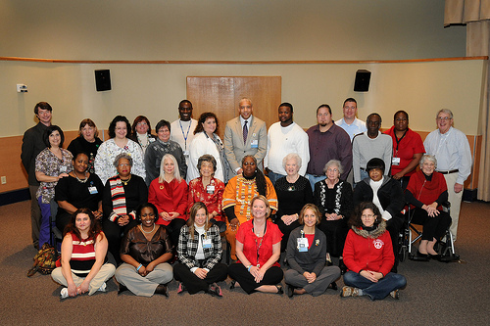
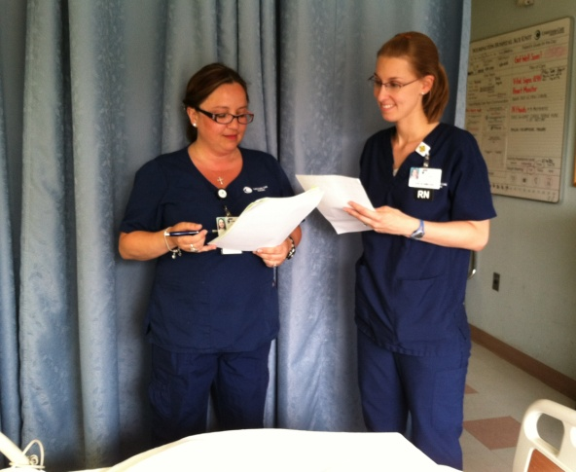
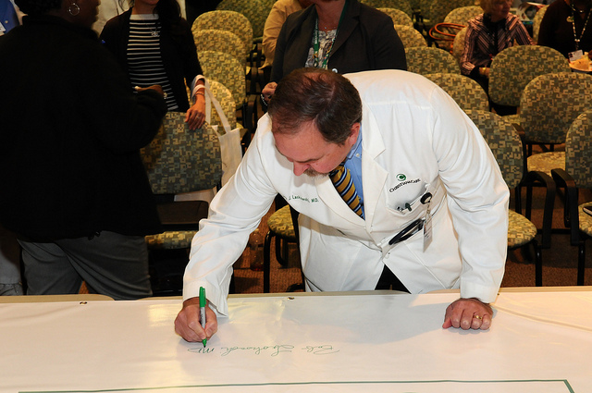
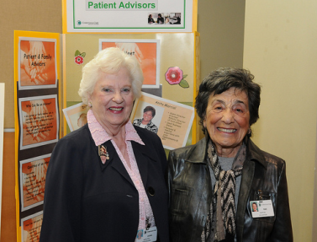
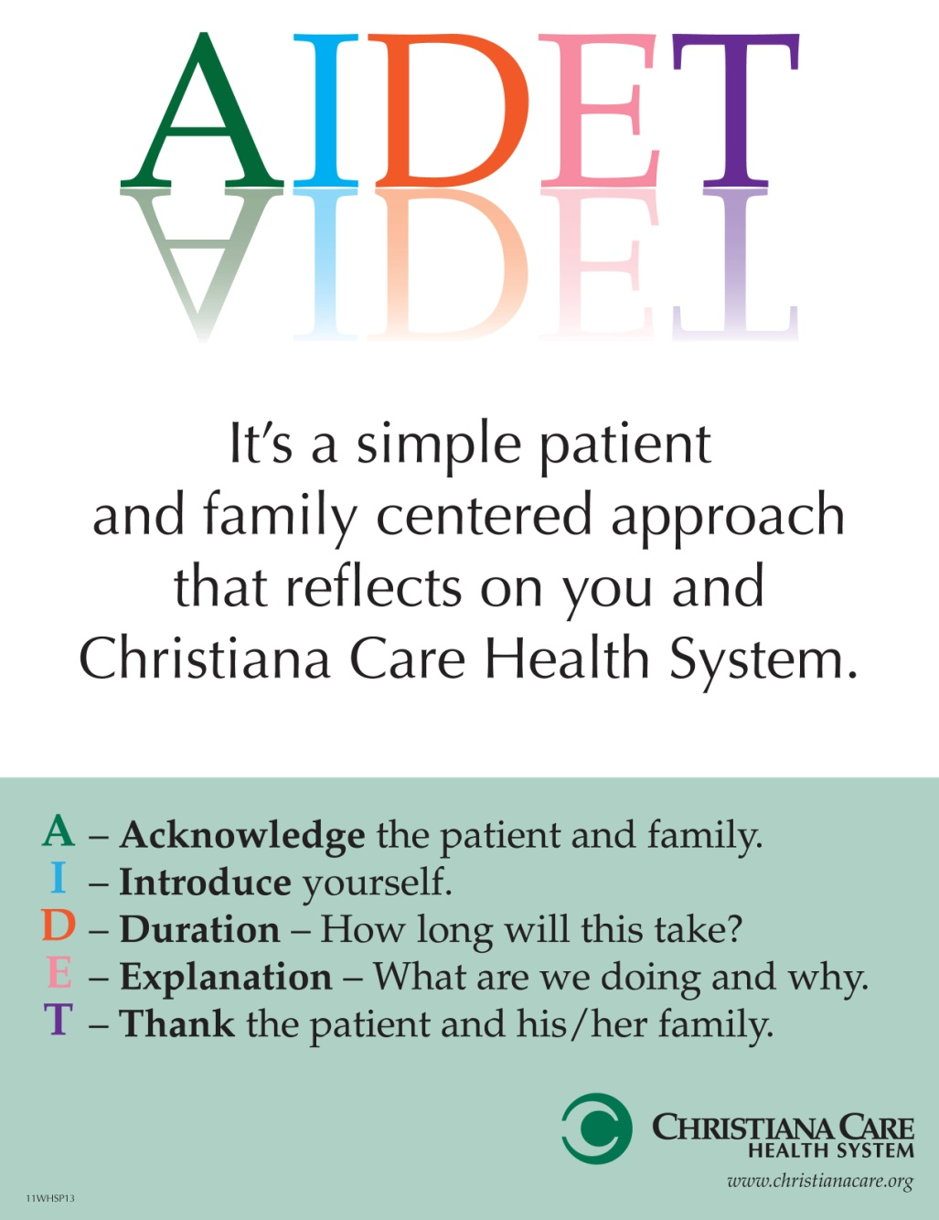
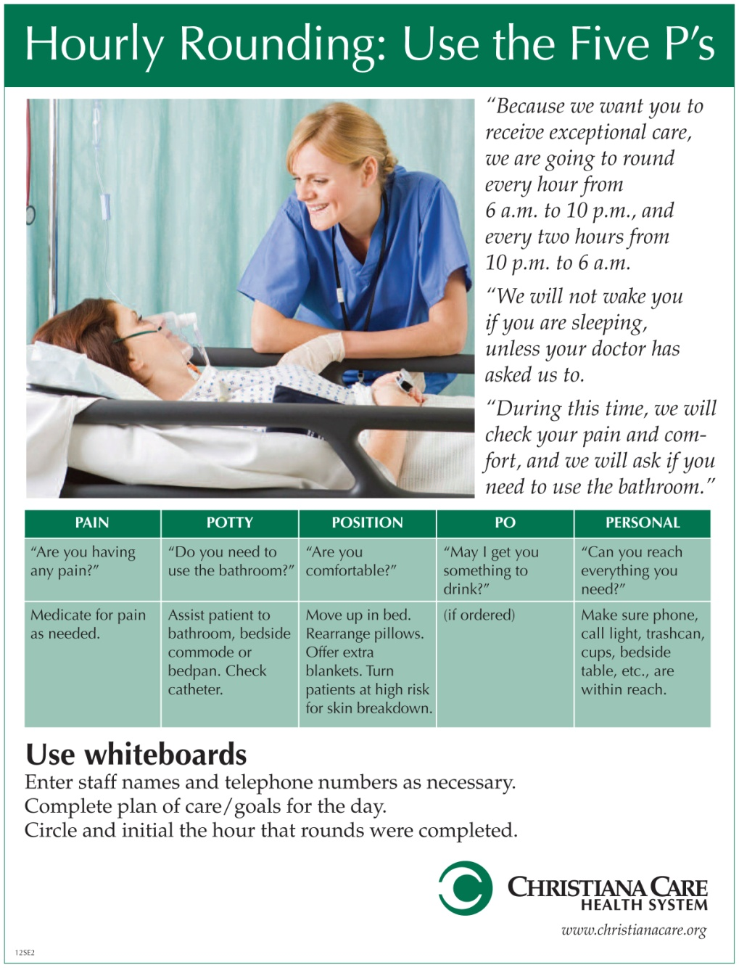
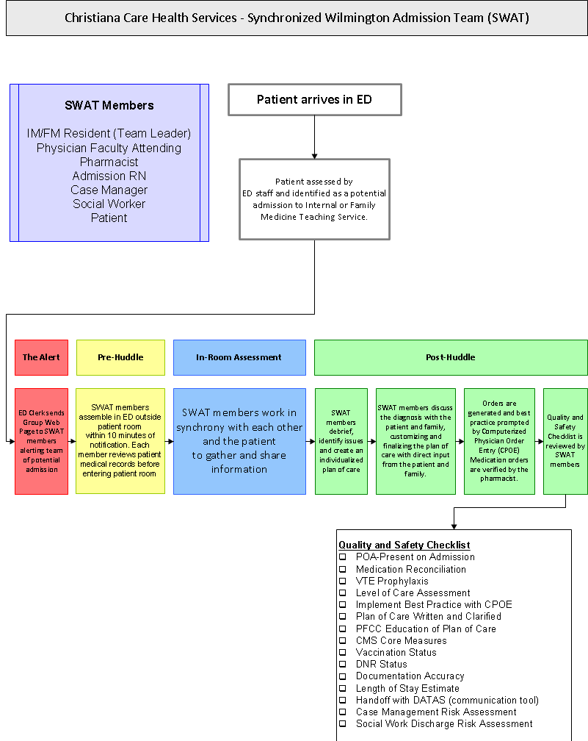
One Voice: One Hospital’s Journey to Transform Inside and Out by Incorporating Patients and Families into the Health Care Team
Dannette Mitchell, BSN, RN, CCRN, Paula Tomanovich, BSN, RN, BC, Jo Melson, MSN, RN, FNP-BC, Shelley Nix, Sr. Patient Representative, and Penelope Seiple, MSN, RN, NE-BC, Vice President of Patient Care Services
Background
Christiana Care Health System consists of two campuses - Newark and Wilmington, with more than 1100 acute care beds and over 10,400 employees.
Wilmington Hospital, the smaller of the two, chose to be first to dive into this exciting new way of delivering patient care.
Wilmington Hospital was beginning a new expansion project and with that expansion wanted to begin a journey that would not only transform our external appearance, but also our culture.
2008 Christiana Care Wilmington Hospital embarked on a journey to adopt the practices and core principles of PFCC. Our sights were set on lasting and internal change in the culture of our hospital and ultimately, our entire health system.
Patient and Family Centered Care Practices
Results
Patient and Family Quotes
“You guys must be doing something different, everyone spoke to
me as I came through the hall” (after implementation of AIDET)
“ I can tell that the nurses in this hospital are passionate about
nursing” (during Nurse Manager rounds)
“ When you all (the team) come in here and talk with me like this, it
shows you care and makes me want to take my medicine” (during
Interdisciplinary Rounds)
“ Communication here has been outstanding, empowering me to
make decisions” (comparing to previous admission)
HCAHPS
Improvements in all categories except one (physician communication)
Statistically significant improvements in three measures
Response of hospital staff
Pain management
Communication re: meds
Bedside Shift Report
March 2011- All inpatient units were conducting shift report at the bedside including patients/families
June 2011- Evaluation of BSR with 77% of Wilmington Hospital nurses was completed
Live bedside peer evaluation performed with patient and/or family participation.
Findings presented to nursing leadership and staff nurses
Benefits:
BSR moves communication to the point of care at the bedside
BSR provides a real-time picture for the oncoming nurse “worth a thousand words”
BSR is a mechanism to include patients and families in the plan of care through the provision of timely and relevant information
Opportunities:
Develop standardized, consistent format for BSR and expectations among all units
Provide algorithm to manage exceptions
Increase communication skills and comfort level between nurses and patients/ families
SharePoint
A PFCC web based tool to serve as a reference for staff
Through expert consultation achieved an attractive, readable, organized electronic resource that is readily accessible to all staff
Introduces & describes patient and family centered practices & behaviors
Organized into ‘toolkits’ with simple step by step instructions backed by evidence, research & hands on experience
Challenge remains to keep the site updated & fresh
Path forward includes adding links to other resources
Patient and Family Advisory Council
Fall 2008- First advisor joined One Voice, helping
us to prioritize our work.
October 2010- Patient and Family Advisory Council
was developed under the guidance of the PFAC Steer
Committee with the addition of two new advisors
Guiding Principles were developed
Recruitment for more members began
May 2011- The first meeting of our Wilmington
Hospital Patient and Family Advisory Council was held with
12 Patient and Family Advisors
June 2011- Staff Advisors were selected and added to
the PFAC
White boards
Wilmington Hospital Patient Satisfaction HCAHPs
Our Beginning
One Voice is the name of the Steer Committee that pioneered
PFCC activities at Christiana Care.
Members of One Voice and other Christiana Care leaders and staff visited Georgia Health Sciences University (previously known as Medical College of Georgia) in 2008. From that visit, the vision became clear. It was no longer if something should be done or even what should be done, it was just a matter of how and when.
One Voice expanded to include departments other than inpatient nursing.
Members went to various training sessions throughout the country, and the practices and behaviors were defined.
October 2010- PFCC Launch week at Wilmington Hospital, officially acknowledging our plan to change how we care for our patients
Keynote speaker
Practice Fair- Introduction of All Practices
Patient and family member stories on videos
Signing of our Patient and Family Centered Care Pledge
December 2010- Practice teams were formed. Leaders recruited team members , teams recruited unit-based champions and together they planned activities for each practice to go live throughout the departments simultaneously
March 2011 Bedside Shift Report
April 2011 AIDET Awareness Day
June 2011 Bedside Shift Report (BSR) Assessments
August 2011 Whiteboards
October 2011 Purposeful Hourly Rounds
December 2011 Nurse Manager Rounds
October 2011- PFCC Launch at Christiana Hospital
Nurse Manager Rounds
Nurse managers meet with patients/families daily
Identify & address concerns
Validate quality of care given
Recognize staff for service excellence experienced by the patient
Qualitative Impact:
In a culture of rotating nurses and doctors, the nurse manager can provide a consistent face for the patients and their families.
Nurse Managers who engage in this practice self-report that they have a better handle on what is going on in their areas.
“I can look at the chart and see the numbers, but the best way for me to do it (know we are providing the safe, quality care) is to look at the patient.”
“Nurse manager rounds is a method of validating safety and quality from our most reliable source: the patient”
Synchronized Wilmington Admission Team
(SWAT)
SWAT is a re-engineered
admission process in which a
patient is simultaneously
evaluated
by a multi-disciplinary admitting
team including the physician team,
nurse, pharmacist, case manager,
and social worker
This process redesign drives
improvement which adds value to
patients and providers
Path Forward
One Voice:
Combine behavior practice teams into a “nursing
bundle” concept using the same Practice Champions
Integrate into current nursing Shared Decision Making Structure
Establish One Voice Committee at Christiana campus
Think of Yourself as a Patient Team:
Systemwide interdisciplinary committee established as
an umbrella for One Voice teams, Patient and Family
Advisory Councils, Systemwide awareness and education
of PFCC activities
One Voice
Team Members
Penny Seiple, MSN, RN, NE-BC, VP Patient Care Services, Wilmington Hospital - Chair
Janice Nevin, MD, CMO, Christiana Care - Past Chair
Edmondo Robinson, MD, Physician in Chief, Wilmington Hospital
Diane Bohner, MD, Medical Director of PFCC and Resource Management
Dannette Mitchell, RN, WICU, Coordinator PFCC Practices WH - AIDET
Rae Burton, Ed.D, Patient and Family Advisor
Felisha Alderson, RN, NM, Rehabilitation- Whiteboards
Karen Amato, Nursing Resources- Whiteboards
Marge Bailey, RN, NM, Psychiatry- SharePoint
Janine Jordan, MD, Advisor CM- SWAT
Erin Kavanaugh, MD- SWAT
Michael Knorr, RN, NM, 5 North- Whiteboards
Melva Lane, RN, NM, 3 Surgical- Purposeful Hourly Rounding
Shelley Nix, Sr. Patient Representative- PFAC
Rani Singh-Patel, MD- SWAT
Paula Tomanovich, RN, NM, WH-ACE- Bedside Shift Report
Susan Angeline, RN, NM, Emergency Department
Donna Casey, RN, NM, WICU
Theresa Foraker, RN, NM, Center for Advanced Joint Replacement
Lisa Hall, RN, Case Manager
Shane Hoffman, External Affairs
Debra Kling, LCSW, Social Worker
Jo Melson, FNP-BC
Bonnie Osgood, RN, NM, 4N
Kathy Pereira-Ogan, RN, Director Service Excellence
Maryann Sosnowski, RN, NM, Post Anesthesia Care Unit
Poster printed by Visual Presentation Technology Services, Christiana Care Health Services 20120601

